Slide 1
How to Get RICHHHHHH
SC1015 mini project
Chieh Hsiang, Ren You, Aden
Notes:
Hello, friends. One aspect in life that people use to measure the level of success and happiness is the amount of wealth we have. So, today we would be presenting our findings on “HOW TO GET RICHHHH”.

Slide 2
Problem Statement
01
Dataset & Visualisation
02
Trees
TABLE OF CONTENTS
04
Linear Regression
03
Cross Validation
05
Conclusion
06

Slide 3
01
Problem Statement

Slide 4
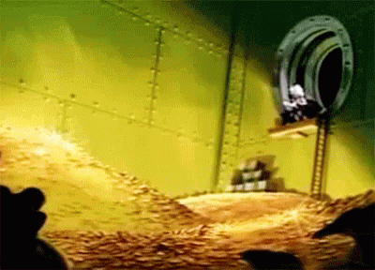
Notes:
This is our group’s motivation. The doughhhhhhhh. How to get $$$$$$.

Slide 5
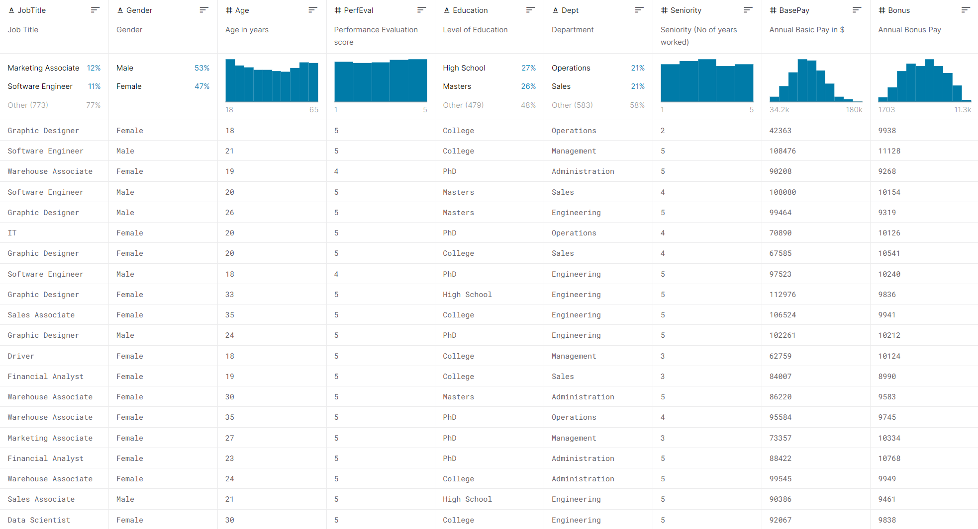
Dataset taken from Kaggle - “Glassdoor - Analyse Gender Pay Gap”
Using data science and machine learning to predict income based on different variables as shown in the picture.
To allow people to predict how much they can receive in the future, so that they can work towards that goal
In life, money is the key indicator to see how successful one is and it is everyone’s goal to be able to earn big bucks
Notes:
Motivation - want to get rich
Hence we chose this dataset from ……
We’ll use the variables in this dataset to predict a high income, and that’ll be our problem statement

Slide 6
02
Dataset & visualisation

Slide 7
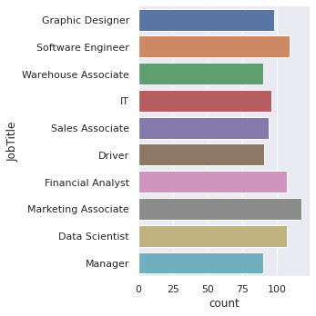
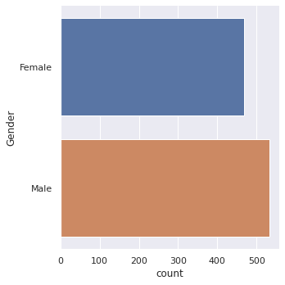
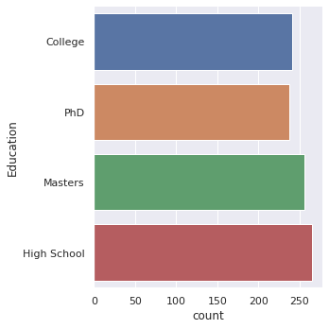
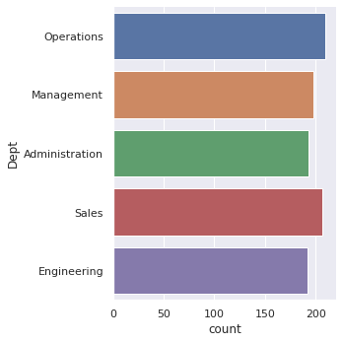
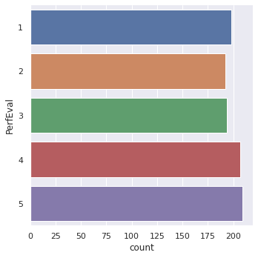
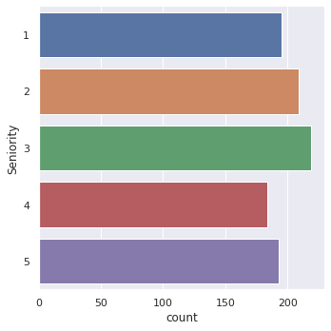
# Column Non-Null Count Dtype
--- ------ -------------- -----
0 JobTitle 1000 non-null object
1 Gender 1000 non-null object
2 Age 1000 non-null int64
3 PerfEval 1000 non-null int64
4 Education 1000 non-null object
5 Dept 1000 non-null object
6 Seniority 1000 non-null int64
7 BasePay 1000 non-null int64
8 Bonus 1000 non-null int64
dtypes: int64(5), object(4)
Notes:
This is the different variables we have. Job title, Gender, Age, Performance evaluation, education, dept, seniority, Base pay and Bonus.
The Data is generally evenly spread out.

Slide 8
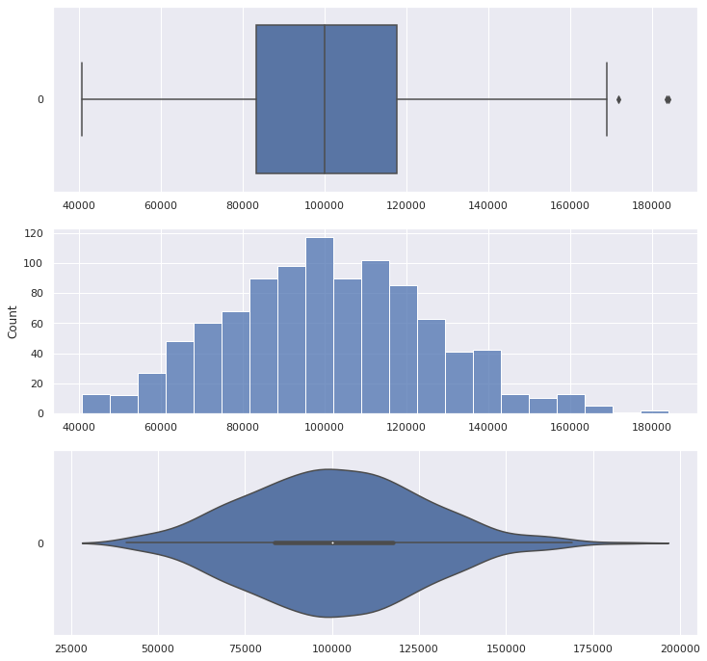
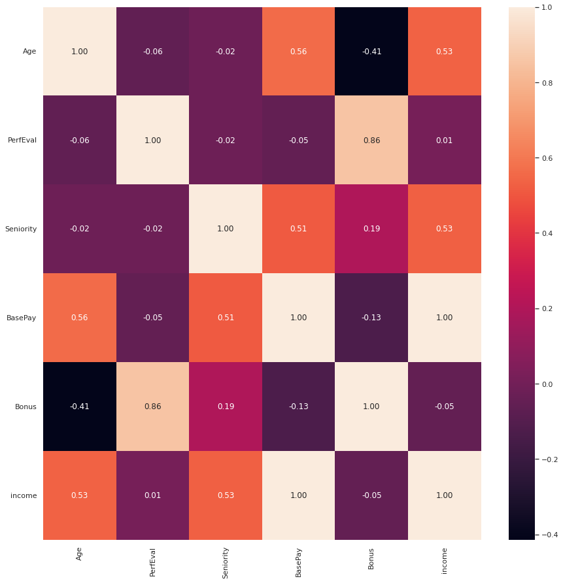
Heat map showing correlation of all variables
Plot for Income (Base Pay + Bonus)
Notes:
Top left you see the combination
Since we want the overall pay, we decided to combine the base pay and bonus to get the overall income. And here are the plots for income. And throughout our analysis later on, we will be investigating the effects of the different variables on income
The figure on the right shows the correlation of the different variables. Looking at the correlation for income, it has the highest correlations with age, seniority and base pay. However, since income is made up of base pay and bonus, we should then exclude out base pay from the analysis of income.

Slide 9
03
Linear Regression
Notes:
Since income is a numeric value and we would like to get the rough estimate of how much income we can get given the different variables, we used a linear regression model to estimate income.

Slide 10
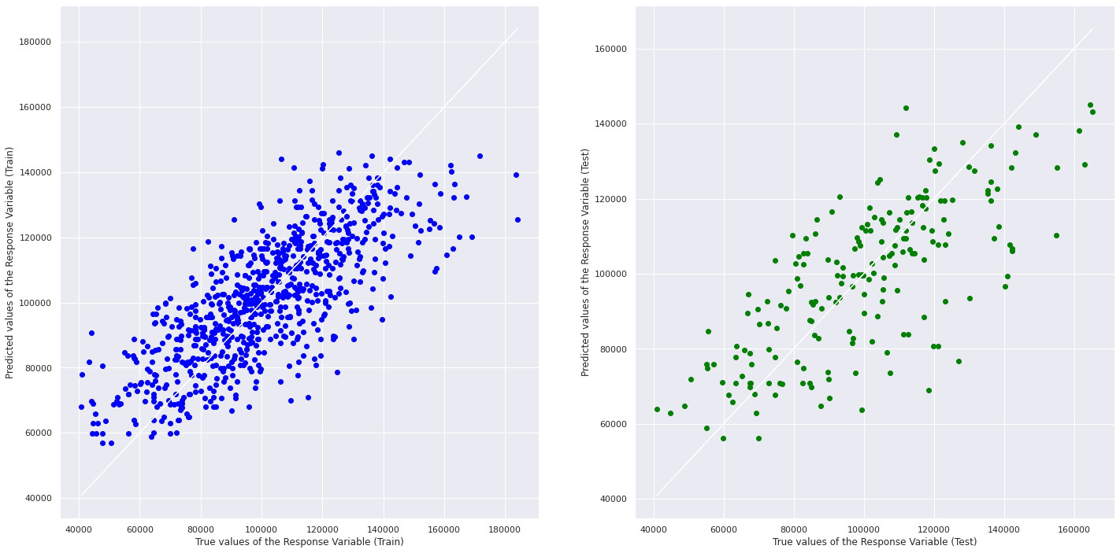
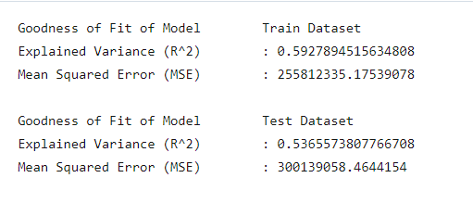
Train and Test Linear Regression with only integer variables
0 JobTitle 1000 non-null object
1 Gender 1000 non-null object
2 Age 1000 non-null int64
3 PerfEval 1000 non-null int64
4 Education 1000 non-null object
5 Dept 1000 non-null object
6 Seniority 1000 non-null int64
7 BasePay 1000 non-null int64
8 Bonus 1000 non-null int64
Notes:
This is the linear regression using Only numeric variable as a factor for predicting the income using linear regression. However, the explained variance is only 0.59 for train and 0.54 for test. This shows that there is very little relation between the variables and income.

Slide 11
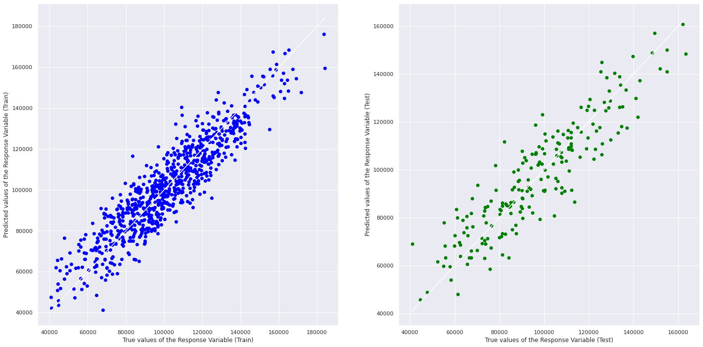
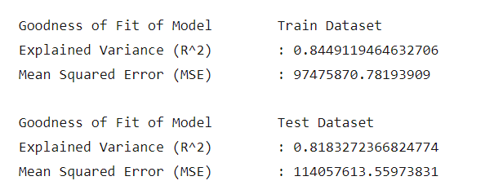
Train and Test Linear Regression with all variables
Done by dummy encoding categorical variables
Notes:
Hence, we introduce categorical data into the independent variable. We did this by dummy encoding categorical data, giving it a numeric representation. By having more variables to train and test the dataset, we achieved an explained variance of 0.84 for train and 0.82 for test. Symbolising a strong relationship.

Slide 12
04
TREES
Notes:
We weren’t satisfied with the 84% accuracy for the linear regression since linear regression predicts income for all all variables our group feels we can further refine the accuracy thus we went with a few different models of tree classification.

Slide 13
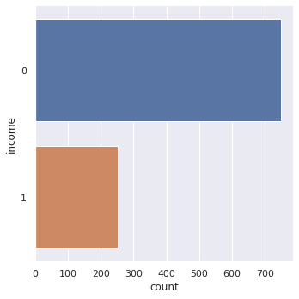
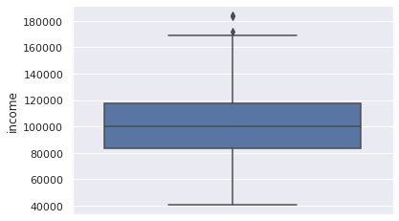
Finding the 75th Percentile
$117656.00
Notes:
Wanting to get rich, we chose to go with the 75th percentile of the income taken from the dataset. Which we found out the about is $117656. Hence, we split the income into 2, 0 for income below third quartile and 1 for income above third quartile.

Slide 14
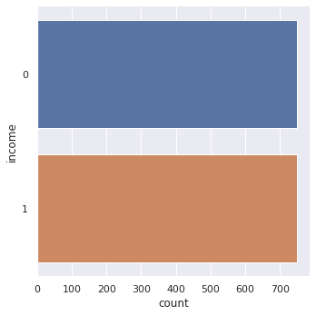
Resampling of Data
Notes:
Also, did data cleaning so we resampled the data so that it is not overly biased towards one side. So the number of people with income above $117656 will be equal to the number less than $117656 with the number of people each being 750.

Slide 15
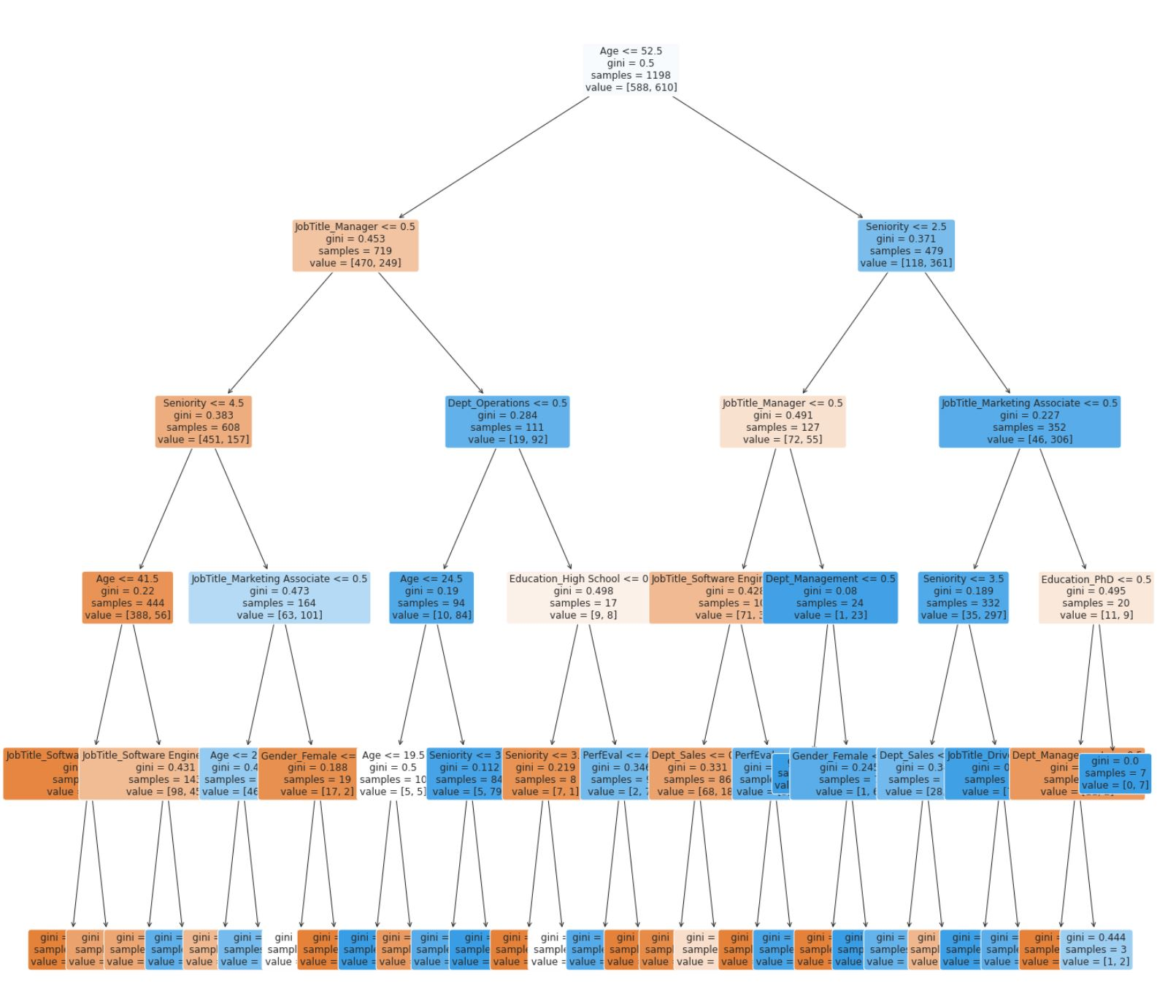
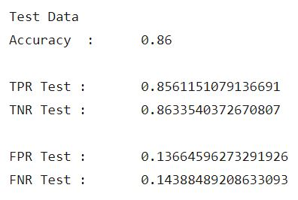
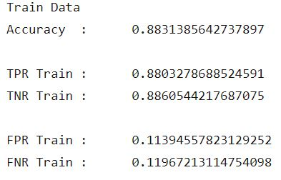
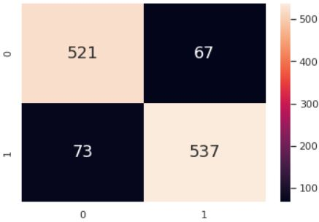
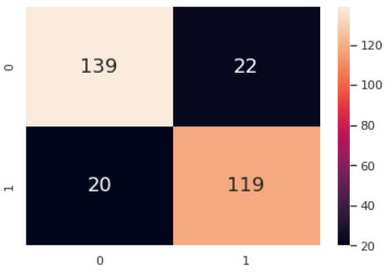
Decision Tree Classifier
Notes:
The first tree model we tested out was a normal binary tree with the decision tree classifier. We ran the tree at a depth of 5 and here are the results. So on the left is a image of the resulting tree. On the right are the confusion matrix and the accuracies based on the train and test datasets. We can see that even with a basic decision tree, we already achieved a higher accuracy than the precious linear regression model, with 86% for the train data and 88% for the test data.

Slide 16
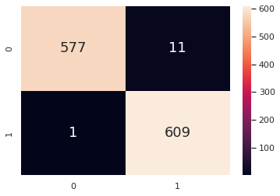
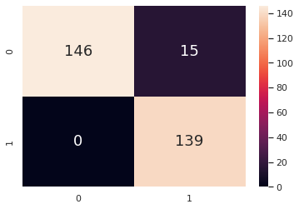
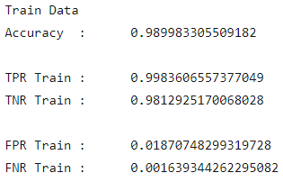
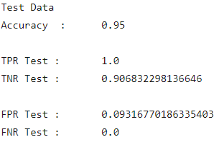
Random Forest Classifier
Notes:
However, we still wanted to look for ways to further improve the accuracy. So we chose to use a random forest classifier with a number of estimators of 400 and at depth 10, and here are the results. As you can see, with the test data, the accuracy increased from 88.3% to 95%, and this is a pretty significant increase. Furthermore, we can see that we even have a 99.8 and 100% true positive rate for the train and test dataset respectively.
However we wanted further explore different better models of machine learning and we came upon the model XGBosst.

Slide 17
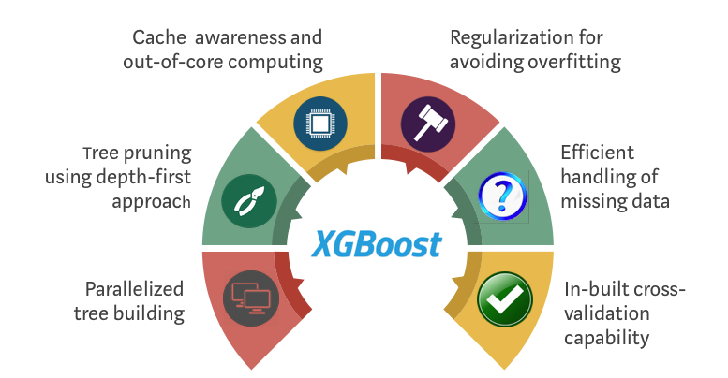
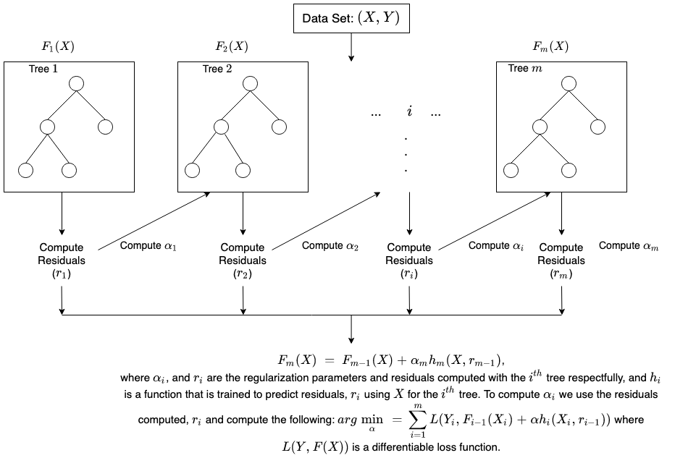
Notes:
XGBoost, which stands for Extreme Gradient Boosting, is a scalable, distributed gradient-boosted decision tree (GBDT) machine learning library. It provides parallel tree boosting and is the leading machine learning library for regression, classification, and ranking problems.
It’s vital to an understanding of XGBoost to first grasp the machine learning concepts and algorithms that XGBoost builds upon: supervised machine learning, decision trees, ensemble learning, and gradient boosting.
Supervised machine learning uses algorithms to train a model to find patterns in a dataset with labels and features and then uses the trained model to predict the labels on a new dataset’s features.

Slide 18
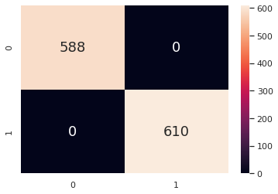
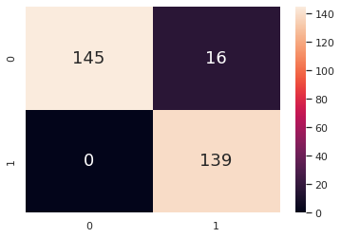
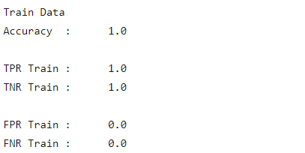
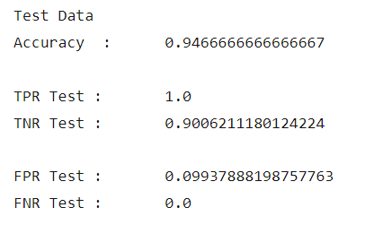
XGBoost
Notes:
With XGBoost the results further improved. We managed to get 100% accuracy for trained dataset with XGBoost. However, the accuracy for the test dataset however marginally deproved.

Slide 19
05
Cross-Validation
Notes:
Lastly, we did cross-validation to find the optimal tuning parameters for a machine learning problem.

Slide 20
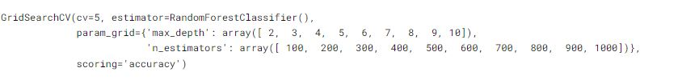
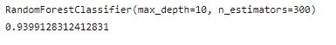
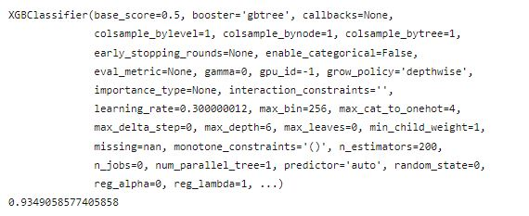
Random Forest
XGBoost
Notes:
As we may encounter overfitting, which means our machine learning model trains too specifically on our training dataset and causes higher levels of error when applied to our test datasets. Or, we may run into underfitting, which means our model doesn’t train specifically enough to our training dataset. This also leads to higher levels of error when applied to test datasets. Hence, the best estimate for random forest classifier is a max depth of 10 and estimator of 300, with a accuracy of 94.0%. XGBoost is a lot more complex with many different variables but the best estimator has a accuracy of 93.5%. Since the dataset is already very close to being 100 % accurate, it is very hard to use a machine learning model to further improve the dataset. And if the model further improves, it may be overfitting of the data.

Slide 21
06
Conclusion
Notes:
In conclusion, the models above did a very good job in predicting the income from our dataset.

Slide 22
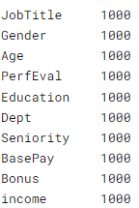
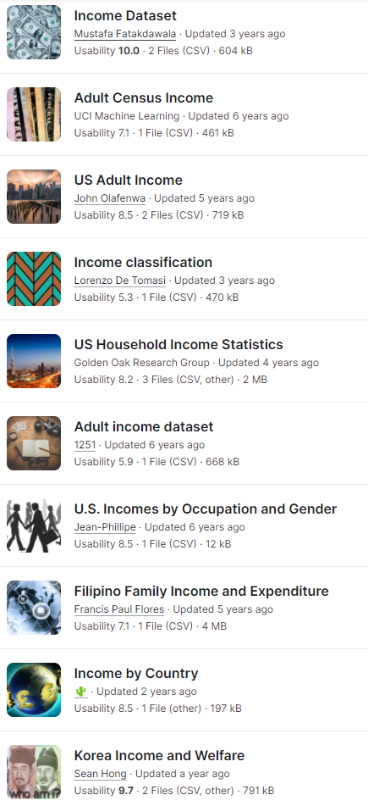
Linear Regression
Decision Tree
Random Forest
XGBoost
Notes:
However, this doesn’t mean it would still be accurate when putting it into real world situations. First of all, our dataset only has a sample size of 1000, which isn’t exactly a lot, and this may lead to inaccuracies. Also, our accuracies for the training models seemed a little too high, which may mean that it is biased. To get a more realistic prediction of high income, we can gather more similar datasets from other sources. It would be a more accurate representation of income in relation to the datas, allowing us to better predict how we are able to get higher income.

Slide 23
THANK
YOU

